Slide 1


Feb-2012
Team MSU - AOCI

Slide 2
Highlights
Motivation Behind MSU
What is MSU
Salient features of MSU
How easy to adapt/use MSU
Where we Stand after OTM
MSU Porting Options

Slide 3


Motivation Behind MSU
TeSys-T had a firmware issue because of which 7000 devices had to be re-programmed!
It uses FTP for upgrading devices
Though FTP is reliable it has some disadvantages:-
  Manual interventions ( Identify the IP address of each device and then establish the connection before sending files).
  Even if there are many devices of the same hardware type and they use the same binary file, the procedure is repeated.
  Uses more network resources (wrt Bandwidth)
  Takes long time if there are many devices.

Slide 4

What is MSU
MSU is a protocol with Client- Server Model based on UDP/IP
  MSU Server is hosted on PC
  It has a GUI from which user can choose the file ( Binary, Executable etc) to be sent on the devices who needs an upgrade
MSU Clients is part of the Device Firmware
  MSU client is developed in C and it can be ported on the devices or is also available as a C library

Slide 5
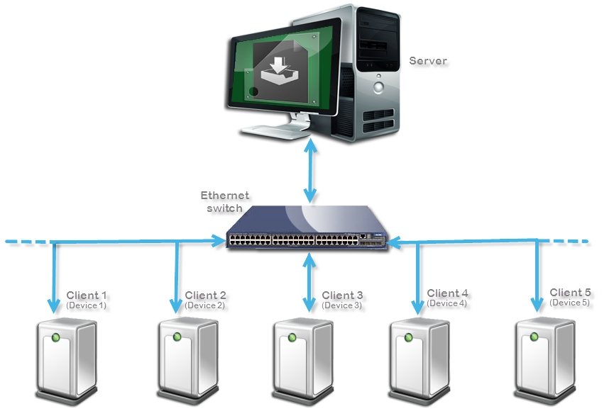
Example of an MSU scenario

Slide 6

Salient feature of MSU
MSU can perform simultaneous file transfer to may devices on the network
Bandwidth consumption will always be equal to 1 device
Time consumption will always be equal to 1 device
MSU creates list of the devices on the network before to start the process
Apply upgrade process on selected group (s)of devices
Multiple groups can be selected simultaneously (different Binaries)
Gives the Status about the devices whether they passed, failed or faulty at the end of upgrade process
Status of file transfer is validated by CRC at the end of file transfer (Optional can be enable/disable by compile time MACRO)

Slide 7
File handling by MSU
Sequence 1
Sequence 2
Sequence 3
Sequence 4
Sequence Size <= UDP data payload
Chunk size = Sequence Size X no of sequence
Sequence 32
Chunk 1
Chunk 2
Chunk n
File

Slide 8
MSU Server Implementation
Divide file in to equal size call chunk
Chunk further divided in to equal size call sequence
Take one chunk and transmit one by one sequence till current chunk finished
Wait for a time period call Sequence Complain (SCM)
Devices those have missed few sequences can ask for retransmission from server
Retransmit the missed sequence if any
Repeat step 3 to 6 till reach the last chunk

Slide 9
MSU Server Implementation Cont…
Wait for a time period call Chunk Complain Mode (CCM)
Devices can ask for retransmission of missed chunk
Retransmit the missed chunk if any
End the process and wait for the status of all devices

Slide 10
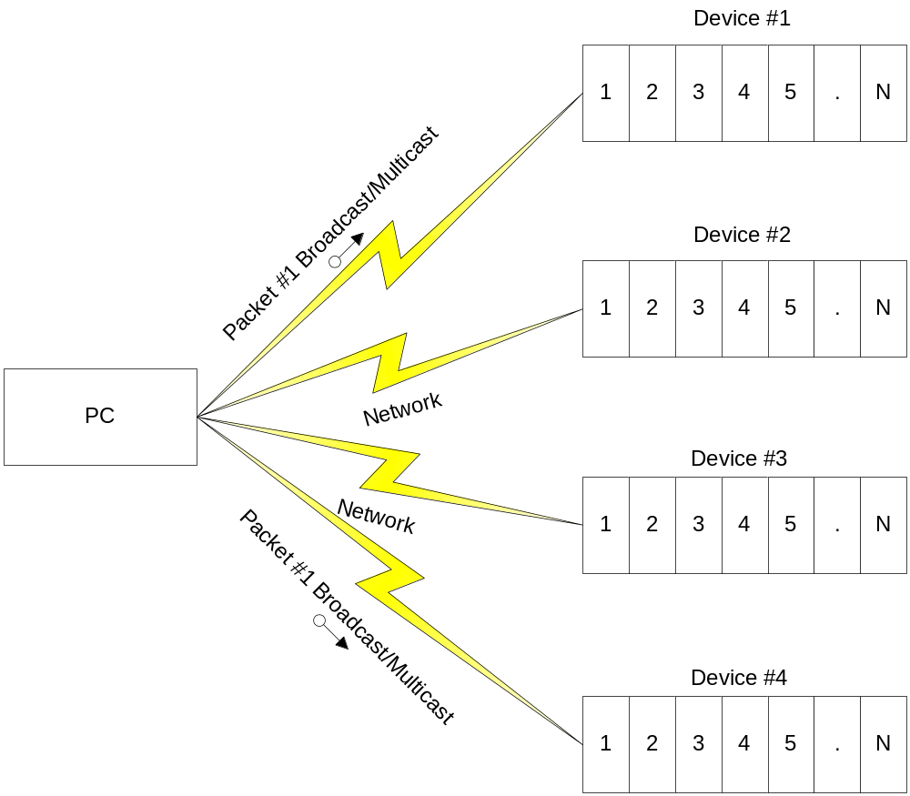
The Proposal of “Mass Up-gradation”

Slide 11
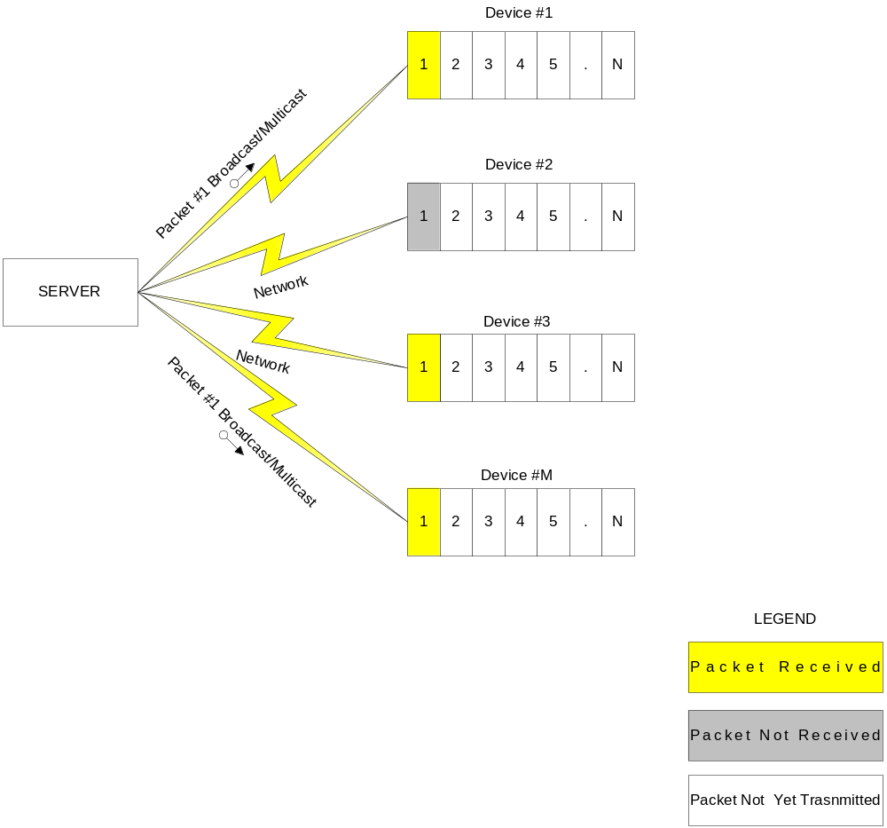
The Proposal of “Mass Up-gradation” ..

Slide 12
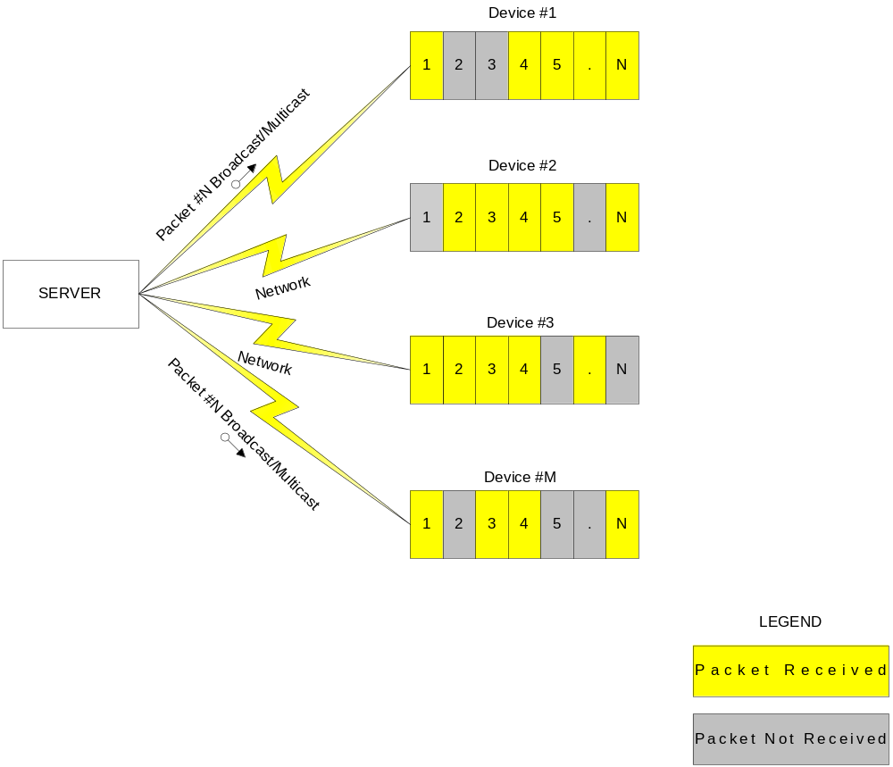
The Proposal of “Mass Up-gradation” ..

Slide 13
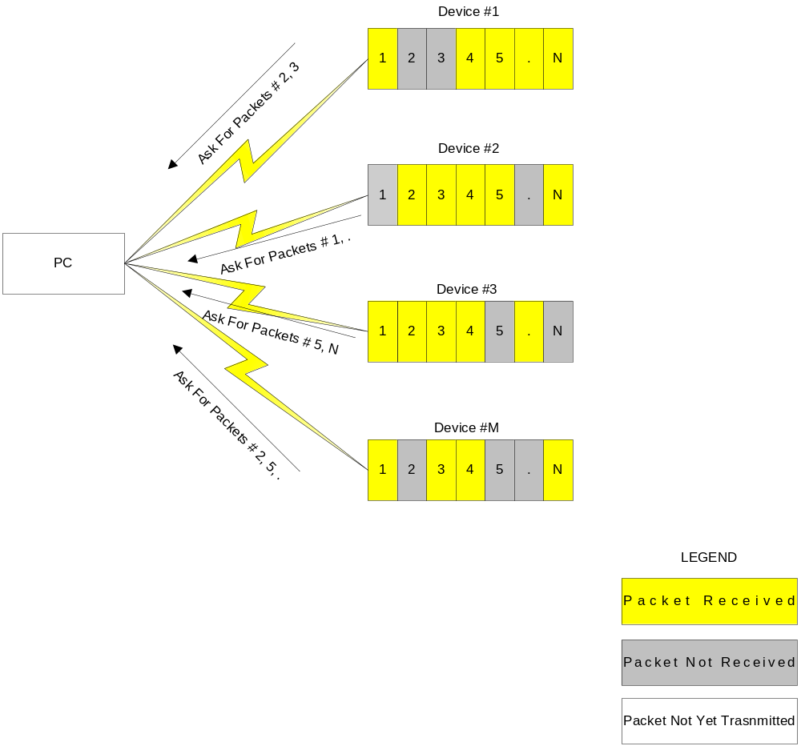
Complain Mode

Slide 14
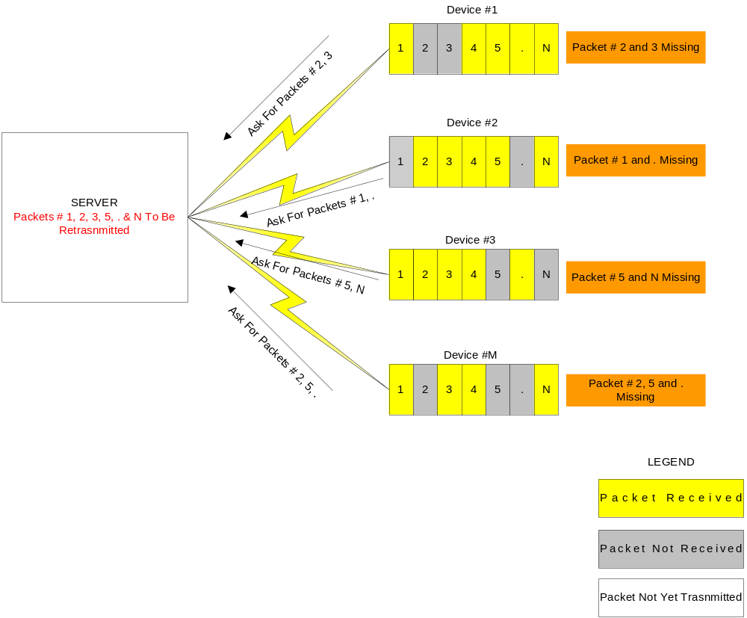
Database Formation & Pattern Matching of Missing Packets

Slide 15
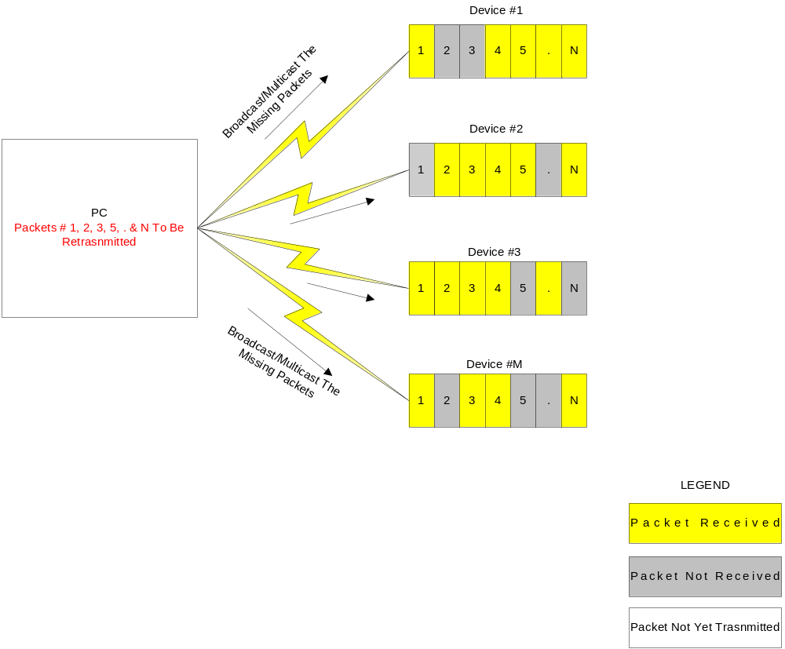
Re-Transmit The Packets

Slide 16
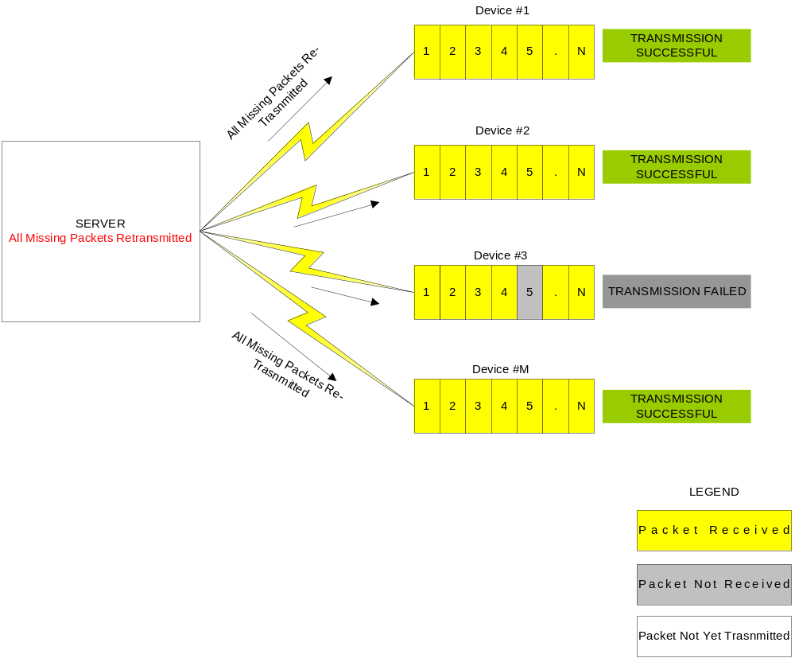
All Missing Packets Retransmitted

Slide 17

How easy to adapt to MSU Client
MSU Client
  Currently MSU only exploit Ethernet (UDP/IP)
  Future may be on many
  MSU is available as C library (source code also available), which can be easily ported
  Currently MSU support two platform (Linux and IPCL (Freescale) )
  The device should have below requirements to adapt to MSU
    Stack required
      UDP/IP
    Number of UDP sockets required
      2
    RAM
      Stack size : 2KBytes
      Global/Heap : 1KBytes + 1.5KBytes(Ethernet Frame size)
    Flash
      Memory Footprint : 12KB (Core component)

Slide 18
MSU Porting Option wrt Temporary storage
  Whole chunk/Image : Cache locally whole chunk and write to file at complete of file transfer
    Pros
      Reduce the sequence delay as well chunk delay interns high performance
      Almost 0 percentage of sequence losses because of sequence processed by TCP/IP stack will be faster
    Cons
      Need to spare the RAM of complete size of file
    Performance
      Almost equal to 1 device time for whole device [ w .r. t. network behavior ]
  Chunk by chunk : Cache locally a chunk and write to file at the every chunk complete
    Pros
      Reduce the sequence delay interns increase the performance
      Reduction of sequence losses interns reduce the number of retransmission because of sequence processed by TCP/IP stack will be faster
    Cons
      Need to spare the memory in the RAM at least the a chunk size
    Performance
      Almost equal to 1 device upgrade time + 10 to 20% added for protocol over head for whole devices [ w .r. t. network behavior ]
  Cont…

Slide 19
MSU Porting Option wrt Temporary storage
  Sequence by sequence : cache locally a sequence and write to file
    Pros
      No need to spare memory in RAM more then a UDP frame
    Cons
      Sequence delay need to be high for file operation
      Sequence losses will more do to file operation. File operation may take more time and TCP/IP stack will loose the next coming packet
    Performance
      Less then the previous method

Slide 20
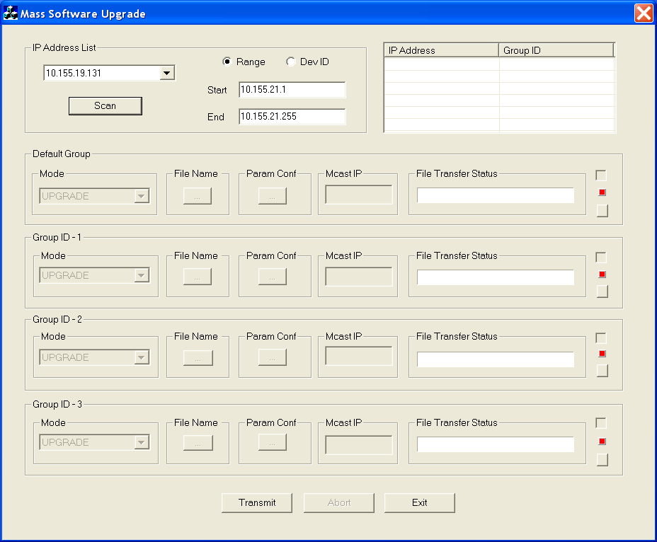
How easy to use MSU Server
MSU server is a standalone PC based application runs on windows XP

Slide 21
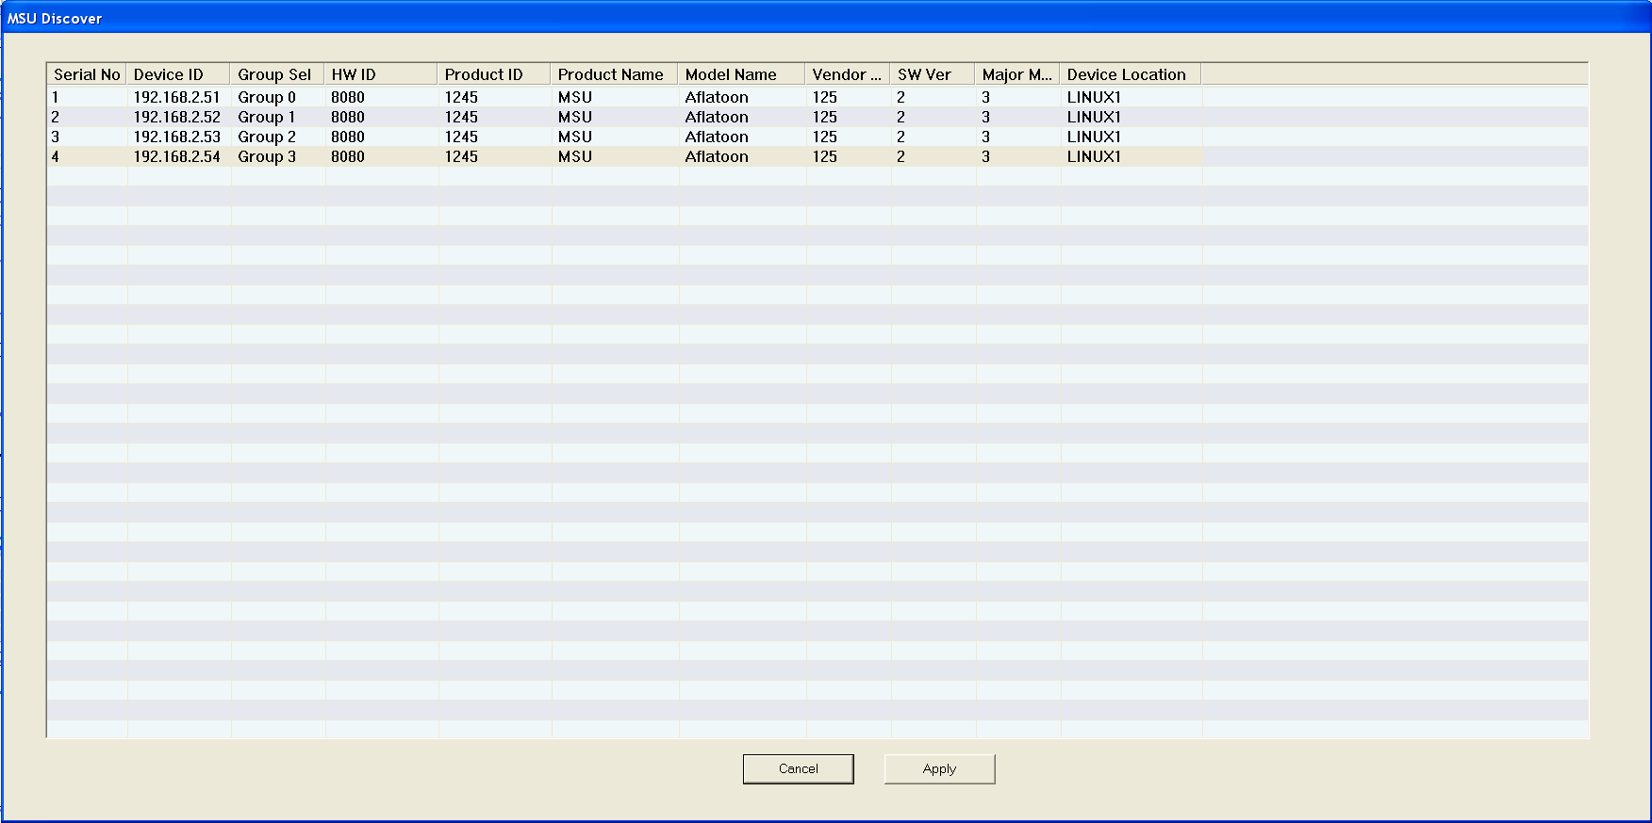
How easy to use MSU server
Discovered devices

Slide 22
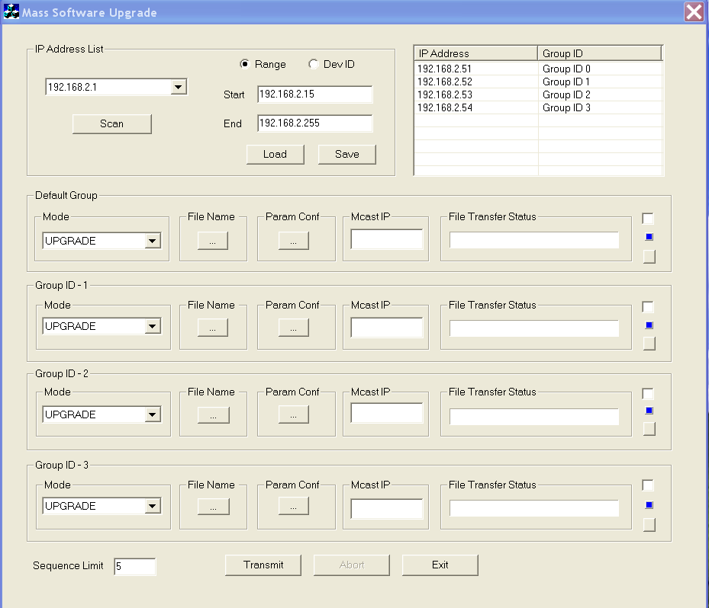
How easy to use MSU server
Group list

Slide 23
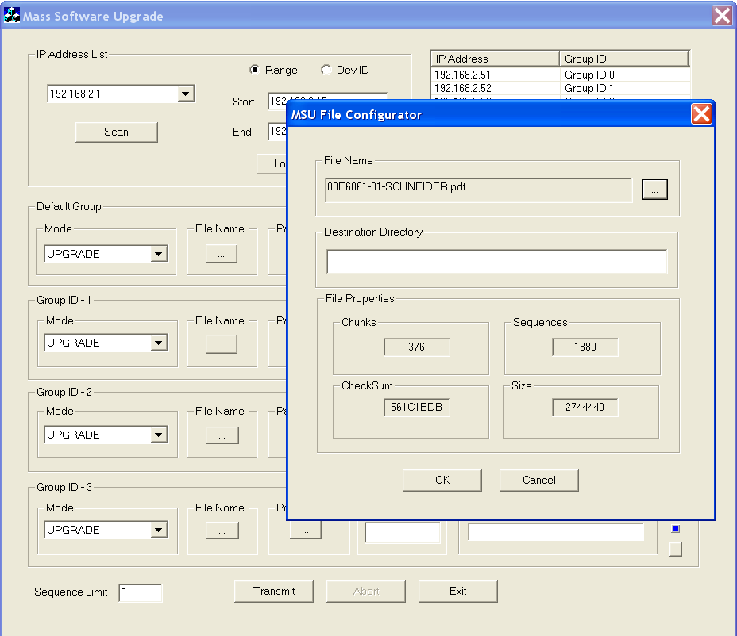
How easy to use MSU server
File selection for different Group

Slide 24
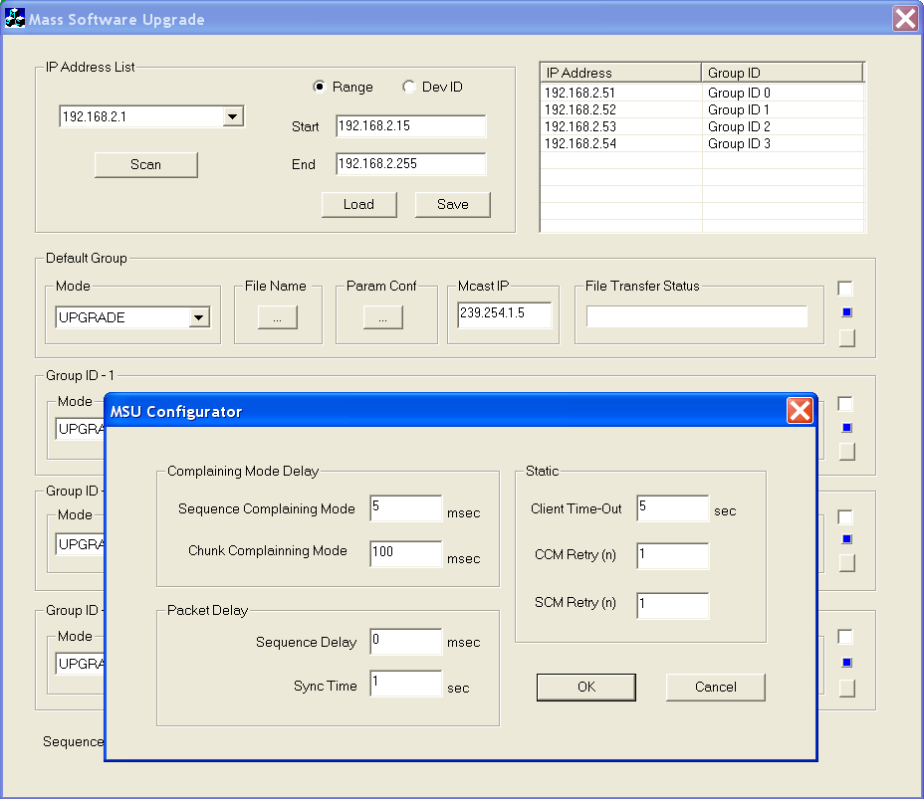
How easy to use MSU server
Communication Parameters selection provided by each Client

Slide 25
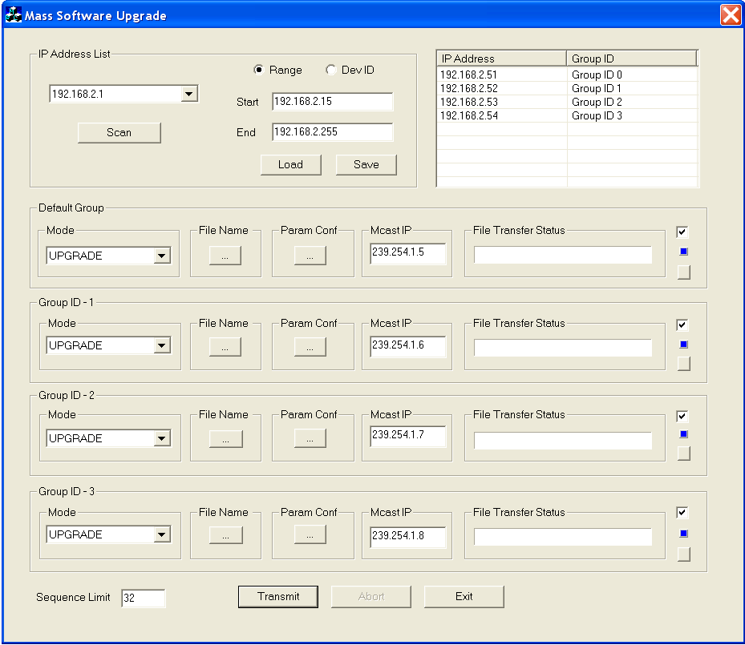
How easy to use MSU server
Ready for Upgrade process
  File selected
  Communication parameters selected
  Multicast IP address is assigned for each group (Automatic)
  Group Selected (Those are going to participate in current upgrade process)

Slide 26
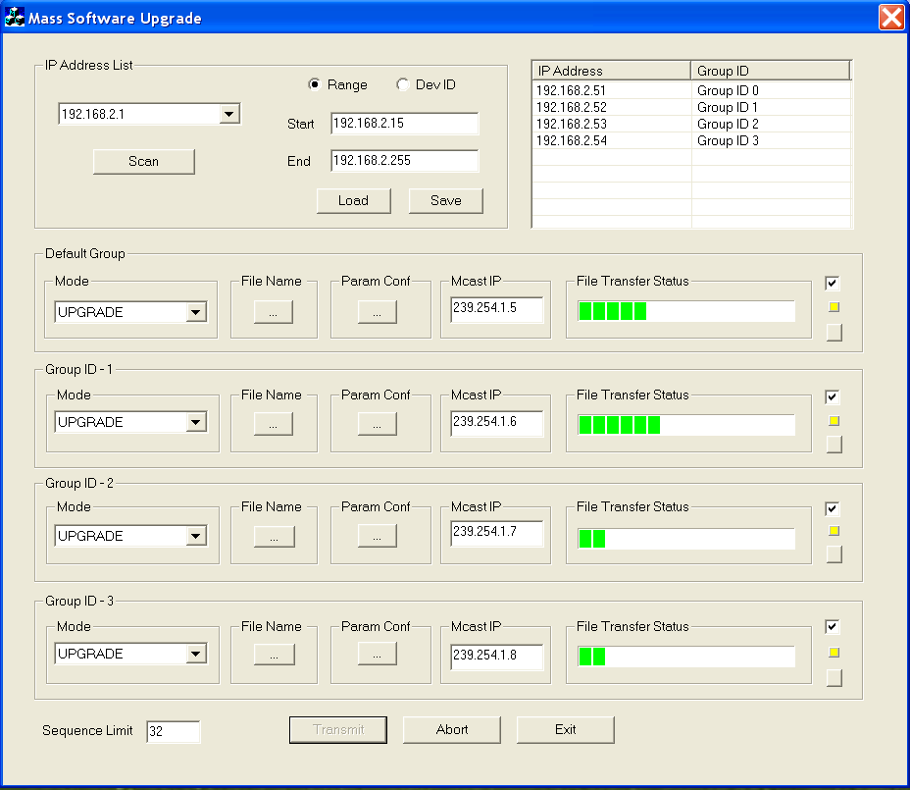
How easy to use MSU server
Start Upgrade process

Slide 27
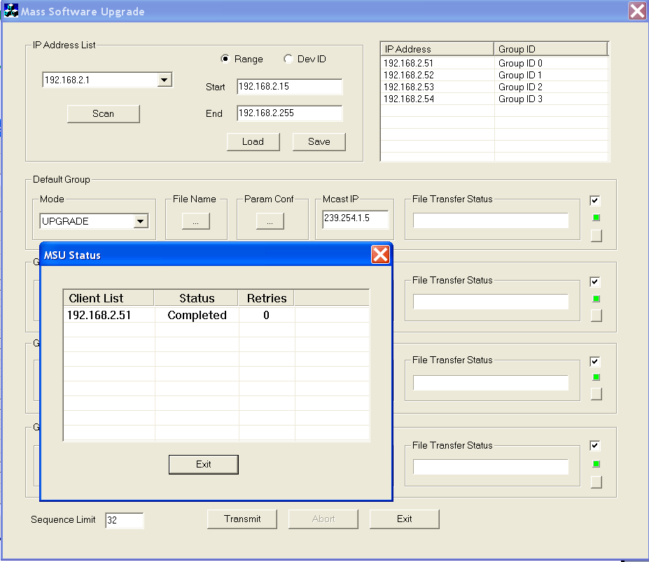
How easy to use MSU server
Finished Upgrade process
  Status of the devices

Slide 28
How easy to use MSU server
Finished Upgrade process
  Status of the devices

Slide 29
How easy to use MSU server
MSU Protocol Specification
MSU Spec

Slide 30
Where we Stand after OTM
Support massive (Common file for all device) only
One to one (each device need specific file) not supported can be expanded
Incremental changes not supported

Slide 31
Thank you for your kind attention !

